Slide 1



KONGU ENGINEERING COLLEGE
PERUNDURAI ERODE-638060
DEPARTMENT OF COMPUTER APPLICATIONS
Optimizing text classification accuracy using machine learning and Deep Learning algorithms
Team Members :
Rajaram S(24MCR080)
Sachin S(24MCR084)
Sangeetha M (24MCR089)
Team Guide:
Ms.Dr.K.CHITRA MCA.,
Team number: 35

Slide 2
ABSTRACT
The project compares machine learning and deep learning techniques for multi-class text classification.
It extends beyond the base paper (which used CNN and LSTM for binary tasks like spam and sentiment analysis) by classifying text into five categories: Politics, Business, Tech, Entertainment, and Sports.
Models used include Random Forest, Support Vector Machine (SVM), and Feedforward Neural Network (FNN).
Preprocessing steps such as tokenization, stopword removal, and vectorization were applied to prepare the text data.
Performance was evaluated using metrics like accuracy, precision, recall, and F1-score to analyze their effectiveness.

Slide 3
PROBLEM STATEMENT
Massive online textual content requires effective automatic classification for better organization and retrieval.
Most existing research targets binary classification tasks like spam detection and sentiment analysis.
There's a gap in research focused on multi-class text classification across domains like politics, business, tech, entertainment, and sports.
Deep learning models like CNN and LSTM perform well but are computationally intensive.
This project uses both traditional (Random Forest, SVM) and deep learning (Feedforward Neural Network) models on a Kaggle-sourced dataset to address multi-class classification.

Slide 4
LITERATURE REVIEW
S.no | Paper title and author | Objective | Algorithm used | Future written
1. | Analytics of machine learning-based algorithms for text classification. Author: Sayar Ul Hassan, Jameel Ahamed, Khaleel Ahmad | In this paper, a comparative analysis of text classification is done in which the efficiency of different Machine learning algorithm on different datasets is analyzed and compared. | Support Vector machine(SVM), k-Nearest Neighbor (k-NN), Logistic Regression (LR), Multinomial Naïve Bayes and Random Forest (RF) | In the future, this research can be expanded to include more algorithms with hyperparameter tuning and ensemble approaches.
2. | Efficient English text classification using selected Machine Learning Techniques. Author : Xiaoyu Luo | In this paper, we implemented the Support Vector Machines (SVM) model in classifying English text and documents. | Support Vector machine(SVM), Naïve Bayes and Logistic regression. | In the future , they can also be implemented in R, Tensors flow, Python, or Matlab simulation tool.
3. | Machine learning based approaches for detecting COVID-19 using clinical text data. Author : Akib Mohi Ud Din Khanday,Syed Tanzeel Rabani, Qamar Rayees Khan, Nusrat Rouf & Masarat Mohi Ud Din. | In this paper, we classified textual clinical reports into four classes by using classical and ensemble machine learning algorithms. Feature engineering was performed using techniques like Term frequency/inverse document frequency (TF/IDF), Bag of words (BOW) and report length. | Random forest, Gradient boosting, Naïve Bayes | In future recurrent neural network can be used for better accuracy.

Slide 5
LITERATURE REVIEW
S.no | Paper title and author | Objective | Algorithm used | Future written
4. | An effective ensemble deep learning framework for text classification Author : Ammar Mohammed, Rania Kora. | The paper extends the results by comparing the performance of the proposed ensemble method to other state-of-the-art ensemble methods. | Convolutional Neural Network(CNN) | In future, instead of using the predicted class label, the probability distributions for each class label of the baseline classifiers improve the proposed ensemble method’s meta-learners’ performance.
5. | A Complete Process of Text Classification System Using State-of-the-Art NLP Models. Author : Varun Dogra, Sahil Verma, Kavita, Pushpita Chatterjee, Jana Shafi, Jaeyoung Choi. | This paper summarizes several machine learning and deep learning algorithms used in text classification with their advantages and shortcomings. | Convolutional Neural Network(CNN) , Recurrent Neural Network(RNN). | In the future that these deep neural networks will be applied efficiently in the automatic monitoring of web-based text data and classifying unseen data into automated labels.

Slide 6
Literature Review
Title: The Convolutional Neural Network Text Classification Algorithm in the Information Management of Smart Tourism Based on the Internet of Things
Author: Lianchao Meng
Published Year: 2024
Algorithms Used: Convolutional Neural Network (CNN),Bidirectional Long Short-Term Memory (BiLSTM),Text Convolutional Neural Network (TextCNN)
Objective: This study aims to develop an efficient text classification model using CNN, BiLSTM, and TextCNN. It enhances sentiment analysis of tourist reviews with deep learning and IoT-driven data processing. The research compares CNN-based models to identify the best approach for automated text classification.
Evaluation Metrics: Accuracy, precision, recall,F1 Score.

Slide 7
SOLUTION STATEMENT
The proposed system involves a pipeline for multi-class text classification using both machine learning and deep learning techniques.
The system is designed to preprocess raw textual data, extract meaningful features, train various classification models, and evaluate their performance.
Multiple algorithms will be employed, including Support Vector Machine, Random Forest and Feed Forward Neural Network.
Feature extraction techniques such as TF-IDF and Word Embeddings will optimize the text representation.

Slide 8
Dataset Description:
RECORDS:
Total records : 2225
Total training data : 1780
Total testing data : 445
FEATURES:
Category – Sports, Entertainment, Business, Tech, Politics.
Text

Slide 9
Classification of Algorithms
1. Random Forest
Combines multiple decision trees to improve accuracy.
Uses bagging (bootstrap aggregation) for robustness.
Handles imbalanced datasets well.
Suitable for classification and regression tasks.
2. Support Vector Machine
Finds the optimal hyperplane that best separates data points into classes.
Effective in high-dimensional spaces and with clear margin separation.
Works well for both linear and non-linear classification using kernel tricks.
Robust to overfitting, especially in low-sample, high-feature datasets.
Suitable for classification and regression tasks (SVR).

Slide 10
3. Feed Forward Neural Network
Consists of input, hidden, and output layers connected in one direction (no cycles).
Processes input data as flat vectors, learning complex non-linear patterns.
Suitable for structured data and basic text classification tasks.
Requires fixed-size input, typically after vectorization or embedding.
Training involves backpropagation and gradient descent to minimize error.

Slide 11
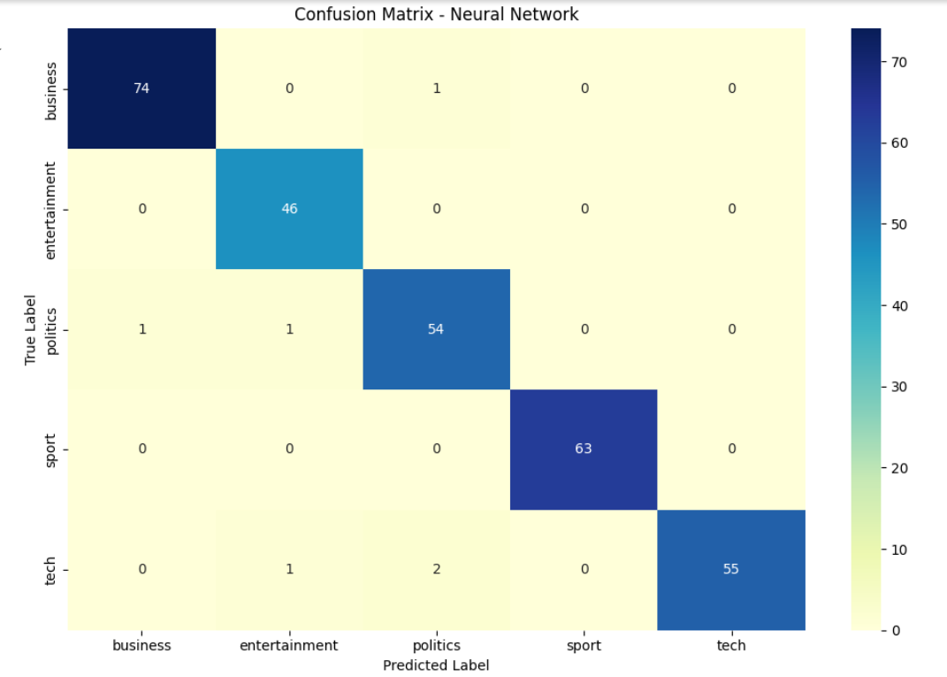
Predicted Label (FNN):

Slide 12
Result and Conclusion:
Text classification was performed using both machine learning (Random Forest, SVM) and deep learning (Feedforward Neural Network) models.
The base paper used CNN and LSTM and achieved an accuracy of 85%.
Our models achieved higher accuracies: Random Forest and SVM – 96.98%, and FNN – 97.99%.
The Feedforward Neural Network outperformed all other models, showing its effectiveness for structured text data.
Classical ML models and simple deep learning models can outperform complex architectures like CNN and LSTM when proper preprocessing and feature extraction are applied.

Slide 13
REFERENCE
1) A. Azaria et al, Medrec: Using blockchain for medical data access and permission management, 2016 2nd International Conference on Open and Big Data (OBD), IEEE, 2016.
2) M. Sheshikala, D. Rajeswara Rao and R. Vijaya Prakash, Computation Analysis for Finding Co– Location Patterns using Map–Reduce Framework, Indian Journal of Science and Technology, Vol 10(8), DOI: 10.17485/ijst/2017/v10i8/106709, February 2017.
3) M. Gupta, A. Bansal, B. Jain, J. Rochelle, A. Oak, M.S. Jalali, Whether the weather will help us weather the COVID-19 pandemic–Using machine learning to measure Twitter users’ perceptions, Int. J. Med. Inform. 145 (November 2020) (2021) 104340, doi:10.1016/j.ijmedinf.2020.104340.
4) Rabby, G., Berka, P. Multi-class classiﬁcation of COVID-19 documents
using machine learning algorithms. J Intell Inf Syst 60, 571–591 (2023).
https://doi.org/10.1007/s10844-022-00768-
5) Mengnan, W. Research on Text Classification Method Based on NLP. Adv. Comput. Signals Syst. 2022, 7, 93–100. [Google Scholar] [CrossRef]

Slide 14
6) Reusens, M.; Stevens, A.; Tonglet, J.; De Smedt, J.; Verbeke, W.; Vanden Broucke, S.; Baesens, B. Evaluating text classification: A benchmark study. Expert Syst. Appl. 2024, 254, 124302. [Google Scholar] [CrossRef]
7) Dea, W.K. Research on Text Classification Based on Deep Neural Network. Int. J. Commun. Netw. Inf. Secur. 2022, 14, 100–113. [Google Scholar] [CrossRef]
8) C.K. Aridas, et al., Uncertainty based under-sampling for learning Naive Bayes classifiers under imbalanced data sets, IEEE Access. 8 (2020) 122–133.
9) S. Ruan, H. Li, C. Li, K. Song, Class-specific deep feature weighting for Naïve Bayes text classifiers, IEEE Access. 8 (2020) 20151–20159.
10) B.R. Rajakumar, Lion algorithm for standard and large scale bilinear system identification: a global optimization based on Lion’s social behavior, in: 2014 IEEE Congress on Evolutionary Computation (CEC), Beijing, 2014, pp.2116–2123.
11) Nikolentzos, G.; Tixier, A.; Vazirgiannis, M. Message Passing Attention Networks for Document Understanding. Proc. AAAI Conf. Artif. Intell. 2020, 34, 8544–8551. [Google Scholar] [CrossRef]
12) Yung-Shen Lin, Jung-Yi Jiang, Shie-Jue Lee, A similarity measure for text
classification and clustering, IEEE Trans. Knowl. Data Eng. 26 (July (7)) (2014)
1575–1590.

Slide 15
THANK YOU

